Slide 1
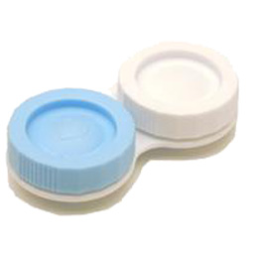
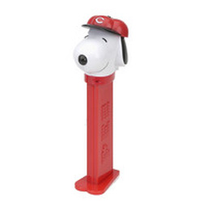
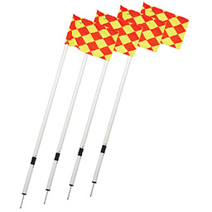
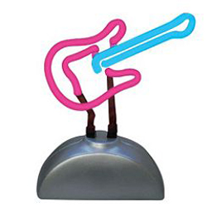
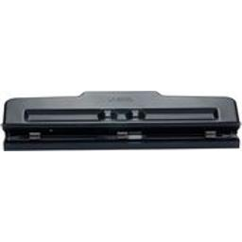
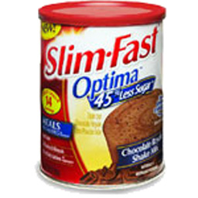
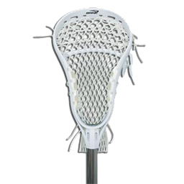

Left Side
Right Side
*
Press ‘F’ = Left side key
Press ‘J’ = Right side key
Press ‘J’ = Right side key
Press ‘F’ = Left side key

Slide 2
Fixation
Fixation
Study
*
*
Test
Test
Response
Response
‘F’ = Left Side Key
‘J’ = Right Side Key
Fixation
Fixation
Study
*
*
Test
Test
Response
Response
‘J’ = Right Side Key
‘F’ = Left Side Key

Slide 3
Spatial Position
Spatial Position
Fixation
Fixation
Study
*
*
Study
Time
Test
Test
Response
Response
‘F’ = Left Side Key
‘J’ = Right Side Key
Fixation
Fixation
Study
*
*
Study
Time
Test
Test
Response
Response
‘J’ = Right Side Key
‘F’ = Left Side Key

Slide 4
Spatial Position
Spatial Position
Fixation
Fixation
Study
*
*
Study
Time
Test
Test
Response
Response
‘F’ = Left Side Key
‘J’ = Right Side Key
Fixation
Fixation
Study
*
*
Study
Time
Test
Test
Response
Response
‘J’ = Right Side Key
‘F’ = Left Side Key

Slide 5
Spatial Position
Spatial Position
Fixation
Fixation
Study
*
*
Study
Time
Test
Test
Response
Response
Left Key
Right Key
Fixation
Fixation
Study
*
*
Study
Time
Test
Test
Response
Response
Right Key
Left Key

Slide 6
Spatial Position
Spatial Position
Fixation
Fixation
Study
*
*
Study
Time
Test
Test
Response
Response
Left Key
Right Key
Fixation
Study
*
*
Study
Time
Test
Test
Response
Response
Right Key
Left Key

Slide 7
Fixation
Fixation
Fixation
*
*
Study
*
Study
Test
Test
Test
Response
Response
Response
‘F’ = Left Side Key
‘J’ = Right Side Key
‘J’ = Right Side Key
Fixation
*
Test
Response
‘F’ = Left Side Key

